Slide 1
M110: Python Programming Meeting #4 Control Structures-2: Repetition Structures
Prepared by Dr. Ahmad Mikati

Slide 2
Contents
4.1 Introduction to repetition Structures
4.2 The for loop
4.3 The while loop
4.4 Sentinels
4.5 Input Validation loops
4.6 Break and Continue statements
4.7 Nested loops

Slide 3
Repetition
On many occasions, programmers need to perform certain tasks repeatedly. It can be tedious to perform such tasks in a sequential way.
It would be much easier if the programmer completes such tasks using loop instructions. Almost all programming languages facilitate the use of control loop statements to repeatedly execute a block of code until a certain condition is satisfied.
In this lecture, we will look at two broad categories of loops:
count-controlled
condition-controlled
A count-controlled loop repeats a specific number of times.
A condition-controlled loop uses a true/false condition to control the
number of times that it repeats.
In Python, you use the for statement to write a count-controlled loop, and you use the while statement to write a condition-controlled loop.

Slide 4


The For Loop
As we have said, a count-controlled loop iterates a specific number of times.
In Python, we use the for statement to write a count-controlled loop.
A for loop is used for iterating over a sequence (a string, a list, a tuple, a range object, etc..), and execute a set of statements, once for each item in a sequence.
The structure of a for loop is as follows:
for <variable name> in <sequence>:
statements to be repeated
Example 1:
The following program will print the characters of the string:
for i in "Stars":
print(i)
The following program will print Hello, along with the value of i, 5 times:
for i in range(5): #(range will be explained in the next slides)
print('Hello’, i)
OUTPUT
OUTPUT

Slide 5
Using the range Function with the for Loop
To loop through a set of code a specified number of times, we can use the range() function.
The range() function returns a sequence of numbers, starting from 0 by default, and increments by 1 (by default), and ends at a specified number.
Syntax:
range(start, stop, step)
Parameter | Description
start | Optional. An integer number specifying at which position to start. Default is 0
stop | Required. An integer number specifying at which position to stop.
step | Optional. An integer number specifying the incrementation. Default is 1
The values we put in the range function determines how many times we will loop.
The range function produces a list of numbers from zero (by default, unless other is specified) to the value minus one.

Slide 6
Using the range Function with the for Loop
Here is an example of a for loop that uses the range function:
for num in range(5):
print(num)
Notice instead of using a list of values, we call to the range function passing 5 as an argument. In this statement, the range function will generate an iterable sequence of integers in the range of 0 up to (but not including) 5.
This code works the same as the following:
for num in [0, 1, 2, 3, 4]:
print(num)

Slide 7
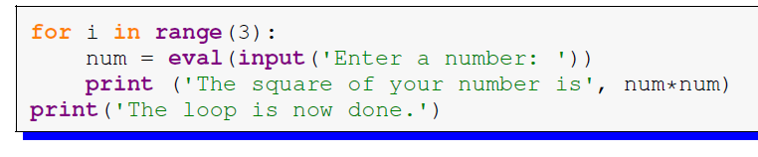
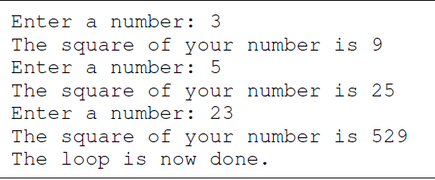
For Loop
Example 2 The program below asks the user for a number and prints its square. It does this three times and then prints: ‘The loop is done’.
No indentation here; so, it is outside the loop
The output:

Slide 8
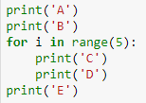
For Loop
Example 3 The program below will print A, then B, then it will C’s and D’s five times and then finish with the letter E once.
A
B
C
D
C
D
C
D
C
D
C
D
E
OUTPUT

Slide 9
More about the range function
If we want the list of values to start at a value other than 0, we can do that by specifying the starting value.
range(1,5) will produce the list 1, 2, 3, 4.
Another thing we can do is to get the list of values to go up by more than one at a time. To do this, we can specify an optional step as the third argument.
range(1,10,2) steps through the list by twos, producing 1, 3, 5, 7, 9.
To get the list of values to go backwards, we can use a step of -1.
range(5,1,-1) will produce the values 5, 4, 3, 2
Note that the range function stops one short of the ending value.

Slide 10
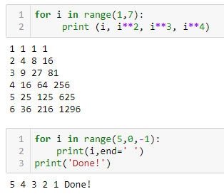
The range function
Examples:
for i in range(1,7):
print (i, i**2, i**3, i**4)
for i in range(5,0,-1):
print(i,end=‘ ')
print('Done!')

Slide 11

The range function
Example: The below codes show 2 different ways to print a string in reverse. One is done using slicing and the other is done using the range function.
Using Slicing
Using range
OUTPUT
text = "Hello World"
revText= text[::-1]
print(revText)
text= "Hello World"
for i in range(len(text)-1,-1,-1):
print(text[i],end="")
dlroW olleH
Recall that in Slicing, by leaving out start, the range will start at the first character. By leaving out the stop, the range will go to the end.

Slide 12
The range function
Example:
Write a program that prompts the user to enter 10 positive numbers, finds and prints the largest number entered by the user, using only one for loop.
N.B: Assume that the user will input only non-negative numbers.
Solution:
Sample output:
Enter 10 positive numbers:
12
2
3
4
22
0
4
6
7
6
The largest number is: 22
print('Enter 10 positive numbers: ')
largest = -1000
for i in range(10):
num = int(input())
if num>largest:
largest = num
print('The largest number is: ',largest)

Slide 13
The while Loop
We have already learned about for loops, which allow us to repeat things a specified number of times.
Sometimes, though, we need to repeat something, but we don’t know ahead of time exactly how many times it must be repeated. This introduces the need of using the condition-controlled loop.
A condition-controlled loop causes a statement or set of statements to repeat as long as a condition is true.
In Python, you use the while statement to write a condition-controlled loop.

Slide 14
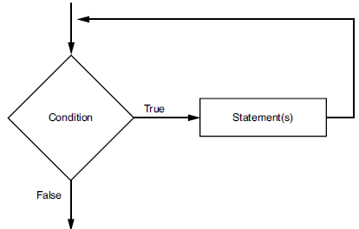
The while Loop
Here is the general format of the while loop in Python:
while condition:
block
The while loop gets its name from the way it works:
while a condition is true, do some task.
The loop iterates while the condition evaluates to true; when the condition becomes false the loop terminates.
The loop has two parts:
(1) a condition that is tested for a true or false value, and
(2) a block (statement or set of statements) that is repeated if the condition is true.
The below Figure shows the logic of a while loop.

Slide 15
The while loop
while condition:
block
OUTPUT
Example:
x = 1
while x < 4: # as long as x < 4...
print (x**2) # print the square of x
x = x+1 # increment x by +1
1
4
9
Note that only the squares of 1, 2, and 3 are printed, because once x = 4, the condition is false, and the loop is terminated

Slide 16
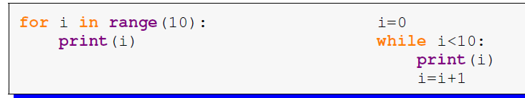
The while loop
The following while and for loops are equivalent
They have the exact same effect:
0
1
2
3
4
5
6
7
8
9
OUTPUT

Slide 17
The while loop
The while Loop Is a Pretest Loop
The while loop is known as a pretest loop, which means it tests its condition before performing an iteration. Because the test is done at the beginning of the loop, you usually have to perform some steps prior to the loop to make sure that the loop executes at least once.
Example:
ans ="y"
# loop will repeat itself as long as ans="y"
while ans=="y":
sal=eval(input("Enter the salary: "))
tax=0.05*sal
print("The tax will be:",tax )
ans=input('Do you want to enter another salary? (Enter y for yes):')
print("Thank you!")
Enter the salary: 500
The tax will be: 25.0
Do you want to enter another salary? (Enter y for yes)y
Enter the salary: 1500
The tax will be: 75.0
Do you want to enter another salary? (Enter y for yes)n
Thank you!
OUTPUT

Slide 18
The while loop
Sentinels
When processing a long sequence of values with a loop, perhaps a better technique is to use a sentinel.
A sentinel is a special value that marks the end of a sequence of items.
A sentinel value must be distinctive enough that it will not be mistaken as a regular value in the sequence.
When a program reads the sentinel value, it knows it has reached the end of the sequence, so the loop terminates.
# loop will repeat itself as long as salary>0
sal=eval(input("Enter the salary, any nonpositive number to stop: "))
while sal >0:
tax=0.05*sal
print("The tax will be:",tax )
sal=eval(input('Enter the salary, any nonpositive number to stop:'))
print("Thank you!")
OUTPUT
Enter the salary, any nonpositive number to stop: 125
The tax will be: 6.25
The net salary will be: 118.75
Enter the salary, any nonpositive number to stop: 0
Thank you!

Slide 19
The while loop
Input Validation
Input validation is the process of inspecting data that has been input to
a program, to make sure it is valid before it is used in a computation.
Input validation is commonly done with a loop that iterates as long as an
input variable references bad data.
# loop will repeat itself as long as the entered value is invalid
grade=eval(input("Enter the grade (between 0 & 20 included) "))
while grade<0 or grade>20:
print('Wrong entry!')
grade=eval(input("Enter the grade (between 0 & 20 included) "))
fgrade=grade*5
print("The grade out of hundred is",fgrade )
print("Thank you!")
Enter the grade (between 0 & 20 included) #21
Wrong entry!
Enter the grade (between 0 & 20 included) # 14
The grade out of hundred is 70
Thank you!
OUTPUT

Slide 20
The while loop
Pitfall to avoid:
while statements are intended to be used with changing conditions.
If the condition in a while statement does not change, the program will be in an indefinite loop until the user hits ctrl-c.
Indefinite loops usually occur when the programmer forgets to write code inside the loop that makes the test condition false.
Example:
x = 1
while x == 1:
print('Hello world‘)
# Indefinite loop! Python will keep printing
# “Hello world” because x does not change!

Slide 21
The while loop
The optional else clause runs only if the loop exits normally (not by break)
OUTPUT
x = 1
while x < 3 :
print (x)
x = x + 1
else:
print (‘The loop ended normally')
1
2
The loop ended normally

Slide 22
The while Loop
Example:
Write a program that reads the grades of several students in a class and calculates the grade-point average for that class. The number of students is unknown, and the program should stop when the user enters any negative number.
count = 0
Sum = 0
grade = float(input('Enter student grade; any negative number to stop: '))
while grade >=0:
Sum += grade
count += 1
grade = float(input('Enter student grade; any negative number to stop: '))
average = Sum/count
print("The average is: ",format(average,'.2f'))
Enter student grade; any negative number to stop: 15
Enter student grade; any negative number to stop: 12
Enter student grade; any negative number to stop: 16
Enter student grade; any negative number to stop: 0
Enter student grade; any negative number to stop: 5
Enter student grade; any negative number to stop: -15
The average is: 9.60
OUTPUT

Slide 23
The break statement
With the break statement we can stop the loop even if the while condition is true:
Condition ?
Loop
False
break causes a jump outside the loop
True
Statement 1
break

Slide 24
The break Statement
Now, consider this program with break
x = 1
while x < 5 :
print (x)
x = x + 1
break
else :
print (The loop ended normally')
print("Done!")
OUTPUT
1
Done!

Slide 25
The continue Statement
With the continue statement, we can stop the current iteration and continue with the next.
Condition ?
continue bypasses the remaining and continues with the next iteration
Loop
False
True
Statement 1
Statements ignored or skipped
continue
Statement n

Slide 26
The continue Statement
Now, consider this program with continue
x = 0
while x < 5 :
x+=1
if x==3:
continue
print(x)
else :
print ('The loop ended normally')
print("Done!")
1
2
4
5
The loop ended normally
Done!
OUTPUT
Notice how the number 3 hasn’t been printed!

Slide 27
Comparison between break and continue
break | continue
It terminates the execution of remaining iteration of the loop. | It terminates only the current iteration of the loop.
'break' resumes the control of the program to the end of loop enclosing that 'break'. | 'continue' resumes the control of the program to the next iteration of that loop enclosing 'continue'.
It causes early termination of loop. | It causes early execution of the next iteration.
'break' stops the continuation of loop. | 'continue’ does not stop the continuation of loop, it only stops the current iteration.

Slide 28
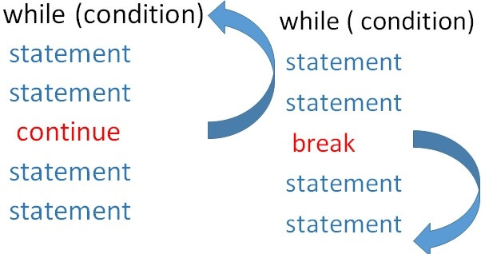
Comparison between break and continue

Slide 29
Comparison between break and continue
Example:
Exit the loop when i is 3:
break
Continue to the next iteration if i is 3:
continue
i = 0 while i < 6: i += 1 if i == 3: break print(i)
i = 0 while i < 6: i += 1 if i == 3: continue print(i)
1 2 4 5 6
OUTPUT
1 2
OUTPUT

Slide 30
Nested loops
A nested loop is an inner loop in the loop body of the outer loop. The inner or outer loop can be any type, such as a while loop or for loop. For example, the outer for loop can contain a while loop and vice versa.
The outer loop can contain more than one inner loop. There is no limitation on the chaining of loops.
In the nested loop, the number of iterations will be equal to the number of iterations in the outer loop multiplied by the iterations in the inner loop.
In each iteration of the outer loop inner loop execute all its iteration.
For each iteration of an outer loop the inner loop re-start and completes its execution before the outer loop can continue to its next iteration.

Slide 31
Nested loops
Nested for Loop
In Python, the for loop is used to iterate over a sequence.
Syntax of using a nested for loop in Python
# outer for loop
for element in sequence:
# inner for loop
for element in sequence:
body of inner for loop
body of outer for loop

Slide 32
Nested loops
Example:
for i in range (2): for j in range (3): print(i," ",j)
Outer loop
Inner loop
OUTPUT
0 0
0 1
0 2
1 0
1 1
1 2
Number from outer loop
Number from inner loop

Slide 33
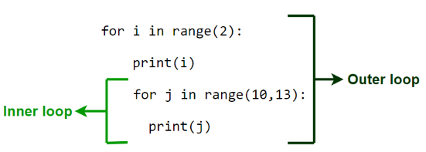
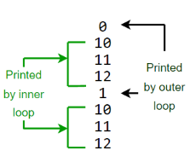
Nested loops
Example:
OUTPUT

Slide 34
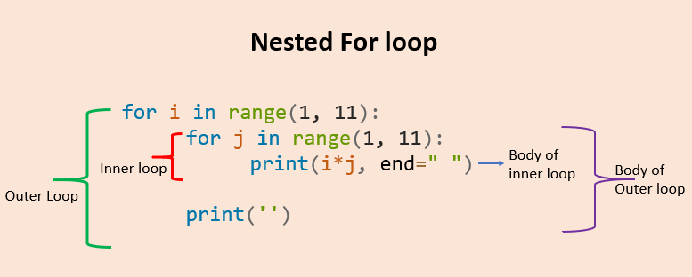
Nested loops
Nested for Loop- Example
1 2 3 4 5 6 7 8 9 10
2 4 6 8 10 12 14 16 18 20
3 6 9 12 15 18 21 24 27 30
4 8 12 16 20 24 28 32 36 40
5 10 15 20 25 30 35 40 45 50
6 12 18 24 30 36 42 48 54 60
7 14 21 28 35 42 49 56 63 70
8 16 24 32 40 48 56 64 72 80
9 18 27 36 45 54 63 72 81 90
10 20 30 40 50 60 70 80 90 100
for i in range(1,11):
for j in range(1,11):
print(i*j, end=" ")
print('')

Slide 35
Nested loops
Nested while Loop
In Python, the while loop can be used to iterate over a sequence as well.
Syntax of using a nested while loop in Python
# outer while loop
while expression:
# inner while loop
while expression:
body of inner while loop
body of outer while loop

Slide 36
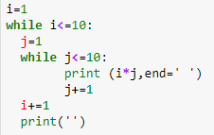
Nested loops
Nested while Loop- Example
1 2 3 4 5 6 7 8 9 10
2 4 6 8 10 12 14 16 18 20
3 6 9 12 15 18 21 24 27 30
4 8 12 16 20 24 28 32 36 40
5 10 15 20 25 30 35 40 45 50
6 12 18 24 30 36 42 48 54 60
7 14 21 28 35 42 49 56 63 70
8 16 24 32 40 48 56 64 72 80
9 18 27 36 45 54 63 72 81 90
10 20 30 40 50 60 70 80 90 100
i=1
while i<=10:
j=1
while j<=10:
print (i*j, end=' ')
j+=1
i+=1
print('')
OUTPUT
Try to enhance the layout of the output!
Outer loop
Inner loop
Body of Outer loop
Body of inner loop

Slide 37
Extra Exercises
Find the output of the following codes:
for i in range (3):
for j in range (5):
print("*",end=" ")
print()
* * * * *
* * * * *
* * * * *
for i in range (4):
for j in range (3):
print(i+j,end=" ")
print()
0 1 2
1 2 3
2 3 4
3 4 5

Slide 38
Extra Exercises
Why this empty line?
Find the output of the following codes:
*
* *
* * *
* * * *
for i in range (5):
for j in range (i):
print("*",end=" ")
print()
*
* *
* * *
* * * *
* * * * *
for i in range (5):
for j in range (i+1):
print("*",end=" ")
print()
for i in range(5,0,-1):
for j in range(i):
print('*', end=" ")
print()
* * * * *
* * * *
* * *
* *
*

Slide 39
Extra Exercises
Write a program that prints the multiplication table for 6 as follows:
1 x 6 = 6
2 x 6 = 12
3 x 6 = 18
…
10 x 6 = 60
number = 6
for i in range(1, 11):
result = i * number
print(f"{i} x {number} = {result}")
Write a program that prints all odd numbers from 1 to 100.
for num in range(1, 101, 2):
print(num)

Slide 40
Extra Exercises
Write a program that prompts the user to enter 10 positive numbers, finds and prints the smallest number entered by the user. You should validate the input.
Why None here?
minimum = None
for i in range(1, 5):
number = eval(input(f"Enter positive number {i}: "))
while number <= 0:
print("Invalid input! Please enter a positive number.")
number = float(input(f"Enter positive number {i}: "))
if minimum==None or number < minimum:
minimum = number
print("The smallest number entered is:", minimum)

Slide 41
Extra Exercises
Write a program that prompts the user to enter 10 numbers, counts and prints the number of positive numbers, negative numbers are zeros entered by the user.
positive_count = 0
negative_count = 0
zero_count = 0
for i in range(1, 6):
number = float(input(f"Enter number {i}: "))
if number > 0:
positive_count += 1
elif number < 0:
negative_count += 1
else:
zero_count += 1
print("Positive numbers entered:", positive_count)
print("Negative numbers entered:", negative_count)
print("Zeroes entered:", zero_count)

Slide 42
Extra Exercises
Write a program that prompts the user to enter positive integers (0 to stop). The program should count and print the maximum integer and the minimum integer entered by the user.
Write a program that prompts the user to enter positive integers (0 to stop). The program then should count and print the number of odd integers and even integers entered by the user.
Write a program that reads from the user a sentence. The program should count the number of occurrences of the character ‘a’ in the sentence.
Write a program that reads from the user 10 words. The program then should count and print the number of words that start with character ‘a’.
Write a program that reads words (“finish” to stop). The program then should count and print the number of words that start with character ‘a’.
Write a program that reads from the user 10 words. The program then should find and print the longest word.
Write a program that reads from the user 10 words. The program then should find and print the shortest word.

